Slide 1
Event Planner App: A Software Development Journey with python and PYQT5
Presented by 24311351019 Anthony Phiri

Slide 2
Project Overview
What is Event Planner App?
A PyQt5-based desktop application for managing events, tasks, and guests.
Built with Python, SQLite, and PyQt5 for a user-friendly experience.
Timeline: March 28 – May 8, 2025 (42 days).
Why this project?
Showcases the full Software Development Life Cycle (SDLC).
Applies software engineering principles to a practical app.
Demonstrates Python for desktop GUI development.
Goal:
Deliver a robust tool for event planning with intuitive features.

Slide 3
Software Development Life Cycle (SDLC)
Phases:
Planning: Define scope and setup environment.
Requirements Analysis: Identify features and requirements.
Design: Create UI and database architecture.
Implementation: Develop core functionality and UI.
Testing: Validate features through tests.
Deployment: Release to staging environment.
Maintenance: Fix issues and document usage.
Approach: Iterative, with overlapping phases for efficiency.

Slide 4
Planning
Objective: Establish project foundation.
Activities:
Set up repository and development environment.
Defined scope: Event planner with authentication, CRUD, and export.
Installed dependencies (PyQt5, requests).

Slide 5
Requirements Analysis
Objective: Specify app functionality.
Activities:
Listed features: Login/signup, event/task/guest management, export, backup.
Defined non-functional requirements: Cross-platform, lightweight database.

Slide 6
Design
Objective: Plan UI and data structure.
Activities:
Designed UI: Login window, main window with tables, dialogs for input.
Created SQLite schema: Tables for users, events, tasks, guests.
Planned MVC-like architecture with PyQt5 and SQLite.

Slide 7
Implementation
Objective: Build the application.
Activities:
Coded user authentication (login, signup, logout).
Developed event, task, and guest management with CRUD operations.
Added fullscreen mode, data export, and backup/recovery.
Enhanced UI with light theme and scrollable tables.
Modularized code into event_planner package.

Slide 8
Testing
Objective: Ensure functionality and reliability.
Activities:
Wrote unit tests for authentication, database, and UI components.
Set up continuous integration (CI) with GitHub Actions.
Fixed bugs identified during testing.

Slide 9
Deployment
Objective: Release the app.
Activities:
Packaged app with run.sh for source execution.
Tested in a staging environment to verify functionality.

Slide 10
Maintenance
Objective: Refine and document.
Activities:
Fixed minor bugs (e.g., UI alignment, database queries).
Created user manual and updated documentation.
Improved code readability and performance.

Slide 11
Version Control with Git and GitHub
Git:
Used for local version control to track code changes.
Commands: git add, git commit, git push, git pull.
Enabled branching for feature development (e.g., main, v0.3, v0.4).
GitHub:
Hosted repository: Anthony-Phiri-533-MW/event-planner-app.
Facilitated collaboration via pull requests and code reviews.
Facilitated tracking with issues and project
Enabled tracking history and code recovery

Slide 12
Commit Template:
Structured commits for clarity and traceability:
#Summary
#Related Issue
#Related commit
#Changes in data
#Changes in interface
Benefits:
Ensured organized development with clear change logs.
Supported teamwork through branching and merging.
Automated testing via CI improved code quality.

Slide 13
Implemented Features
User Authentication:
Signup with secure username/password (6+ characters).
Login with error handling for invalid credentials.
Logout to return to login screen.
Event Management:
Create, edit, delete events (name, date, time, location, description).
View events in a table in the Main Window.
Task Management:
Add, edit, delete tasks (name, due date, status: Pending/In Progress/Completed).
Linked to specific events.
Guest Management:
Add, edit, delete guests (name, contact, status: Invited/Confirmed/Declined).
Linked to events.

Slide 14
Implemented Features (cont.)
Fullscreen Mode:
Toggle fullscreen for better visibility.
Exit via button or Esc key.
Data Export:
Export events, tasks, and guests to CSV (other formats supported).
UI Enhancements:
Light theme for clarity.
Scrollable tables for events, tasks, and guests.
Intuitive dialogs and buttons.
Backup and Recovery:
Backup data to a specified location.
Recover data via settings with URL field.
Database:
SQLite for persistent storage.
Modular event_planner package for clean code.

Slide 15
Gantt Chart
Visualizes: SDLC phases and feature development.
Timeline: March 28 – May 8, 2025.
Colors: Indicate phases (e.g., Implementation: gold, Testing: violet).
Overlaps: Show iterative development (e.g., Testing during Implementation).

Slide 16
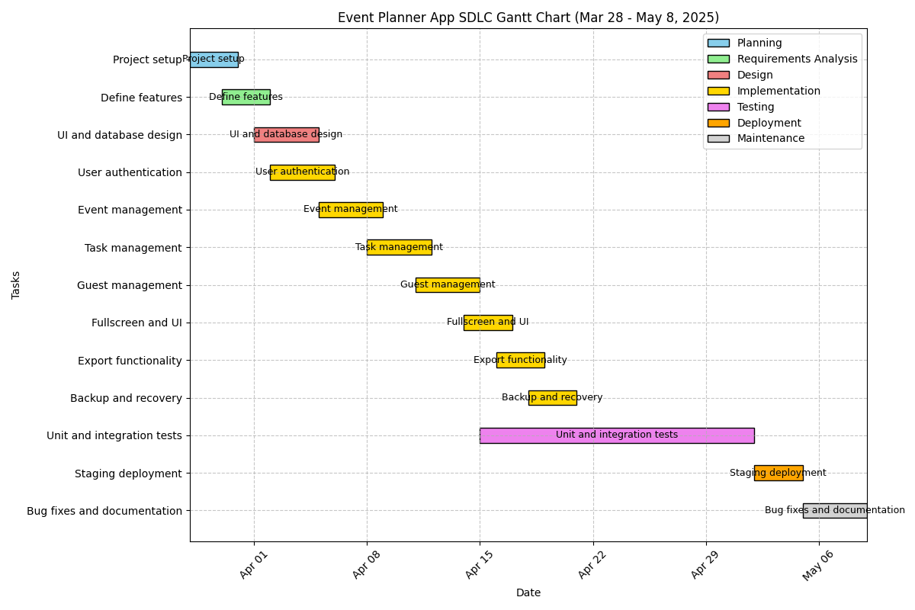

Slide 17
Lessons Learned
Modularity: Organizing code into app.py, database.py, etc., eased maintenance.
Testing: Early testing improved reliability but required more coverage.
UI Design: Iterative enhancements (light theme, scrollers) boosted usability.
Challenges: Handling SQLite connections and PyQt5 layouts required careful debugging.

Slide 18
Conclusion
Achievements:
Delivered a feature-rich event planner in 42 days.
Applied SDLC from planning to maintenance.
Created an intuitive, cross-platform app.
Future Work:
Add more tests for edge cases.
Deploy to production.
Integrate with platforms (e.g., email, WhatsApp).

